Slide 1
UNIT-II

Slide 2
CYBERSPACE
Cyberspace can be defined as an intricate environment that involves interactions between people, software, and services.
It is maintained by the worldwide distribution of information and communication technology devices and networks.
The cyberspace is anticipated to become even more complex in the upcoming years.

Slide 3
REGULATIONS
Information Technology Act, 2000 The Indian cyber laws are governed by the Information Technology Act, penned down back in 2000. The principal impetus of this Act is to offer reliable legal inclusiveness to ecommerce, facilitating registration of real-time records with the Government.
But with the cyber attackers getting sneakier, topped by the human tendency to misuse technology, a series of amendments followed.
The ITA, enacted by the Parliament of India, highlights the grievous punishments and penalties safeguarding the e-governance, e-banking, and e-commerce sectors. Now, the scope of ITA has been enhanced to encompass all the latest communication devices.

Slide 4
Section 43 - Applicable to people who damage the computer systems without permission from the owner. The owner can fully claim compensation for the entire damage in such cases.
Section 66 - Applicable in case a person is found to dishonestly or fraudulently committing any act referred to in section 43. The imprisonment term in such instances can mount up to three years or a fine of up to Rs. 5 lakh.
Section 66B - Incorporates the punishments for fraudulently receiving stolen communication devices or computers, which confirms a probable three years imprisonment. This term can also be topped by Rs. 1 lakh fine, depending upon the severity.
Section 66C - This section scrutinizes the identity thefts related to imposter digital signatures, hacking passwords, or other distinctive identification features. If proven guilty, imprisonment of three years might also be backed by Rs.1 lakh fine.
Section 66 D - This section was inserted on-demand, focusing on punishing cheaters doing impersonation using computer resources.

Slide 5
Section 67-publishing information which is obscene in electronic form.
-Fine 1lakh and 5years punishment.
Section 68-power of controller to give directions
- Fine 2lakhs and 3years punishment
Section 70-protectered system
- Up to 10years punishment
Section 72-penalty for breach of confidentiality and privacy
- Fine 1lakh and up to 2years punishment
Section 73-penalty for digital signature certificate false
--Fine 1lakh and 2years punishment
Section 74-publication for fraudulent purpose
- Fine 1lakh and 2years punishment

Slide 6
Indian Penal Code (IPC) 1980
Identity thefts and associated cyber frauds are embodied in the Indian Penal Code (IPC), 1860 - invoked along with the Information Technology Act of 2000.
The primary relevant section of the IPC covers cyber frauds:
Forgery (Section 464)
Forgery pre-planned for cheating (Section 468)
False documentation (Section 465)
Presenting a forged document as genuine (Section 471)
Reputation damage (Section 469)

Slide 7
Companies Act of 2013
The corporate stakeholders refer to the Companies Act of 2013 as the legal obligation necessary for the refinement of daily operations. The directives of this Act cements all the required techno-legal compliances, putting the less compliant companies in a legal fix.
The legislature ensured that all the regulatory compliances are well-covered, including cyber forensics, e-discovery, and cybersecurity diligence. The Companies (Management and Administration) Rules, 2014 prescribes strict guidelines confirming the cybersecurity obligations and responsibilities upon the company directors and leaders.

Slide 8
NIST Compliance
The Cybersecurity Framework (NCFS), authorized by the National Institute of Standards and Technology (NIST), offers a harmonized approach to cybersecurity as the most reliable global certifying body.
NIST Cybersecurity Framework encompasses all required guidelines, standards, and best practices to manage the cyber-related risks responsibly. This framework is prioritized on flexibility and cost-effectiveness

Slide 9
ROLE OF INTERNATIONAL LAWS
In various countries, areas of the computing and communication industries are regulated by governmental bodies
There are specific rules on the uses to which computers and computer networks may be put, in particular there are rules on unauthorized access, data privacy and spamming
There are also limits on the use of encryption and of equipment which may be used to defeat copy protection schemes
There are laws governing trade on the Internet, taxation, consumer protection, and advertising
There are laws on censorship versus freedom of expression, rules on public access to government information, and individual access to information held on them by private bodies l Some states limit access to the Internet, by law as well as by technical means.

Slide 10
INTERNATIONAL LAW FOR CYBER CRIME
Cybercrime is "international" that there are ‘no cyber-borders between countries’
The complexity in types and forms of cybercrime increases the difficulty to fight back è fighting cybercrime calls for international cooperation
Various organizations and governments have already made joint efforts in establishing global standards of legislation and law enforcement both on a regional and on an international scale

Slide 11
THE INDIAN CYBERSPACE
Indian cyberspace was born in 1975 with the establishment of National Informatics Centre (NIC) with an aim to provide govt with IT solutions. Three networks (NWs) were set up between 1986 and 1988 to connect various agencies of govt.
These NWs were, INDONET which connected the IBM mainframe installations that made up India’s computer infrastructure, NICNET (the NIC NW) a nationwide very small aperture terminal (VSAT) NW for public sector organisations as well as to connect the central govt with the state govts and district administrations, the third NW setup was ERNET (the Education and Research Network), to serve the academic and research communities.
New Internet Policy of 1998 paved the way for services from multiple Internet service providers (ISPs) and gave boost to the Internet user base grow from 1.4 million in 1999 to over 150 million by Dec 2012.
Exponential growth rate is attributed to increasing Internet access through mobile phones and tablets. Govt is making a determined push to increase broadband penetration from its present level of about 6%1. The target for broadband is 160 million households by 2016 under the National Broadband Plan.

Slide 12
NATIONAL CYBER SECURITY POLICY
National Cyber Security Policy is a policy framework by Department of Electronics and Information Technology. It aims at protecting the public and private infrastructure from cyberattacks.
The policy also intends to safeguard "information, such as personal information (of web users), financial and banking information and sovereign data".
This was particularly relevant in the wake of US National Security Agency (NSA) leaks that suggested the US government agencies are spying on Indian users, who have no legal or technical safeguards against it.
VISION
To build a secure and resilient cyberspace for citizens, business, and government and also to protect anyone from intervening in user's privacy.
MISSION
To protect information and information infrastructure in cyberspace, build capabilities to prevent and respond to cyber threat, reduce vulnerabilities and minimize damage from cyber incidents through a combination of institutional structures, people, processes, technology, and cooperation.

Slide 13
Ministry of Communications and Information Technology (India) define objectives as follows:
To create a secure cyber ecosystem in the country, generate adequate trust and confidence in IT system and transactions in cyberspace and thereby enhance adoption of IT in all sectors of the economy.
To create an assurance framework for the design of security policies and promotion and enabling actions for compliance to global security standards and best practices by way of conformity assessment (Product, process, technology & people).
To strengthen the Regulatory Framework for ensuring a SECURE CYBERSPACE ECOSYSTEM.
To enhance and create National and Sectoral level 24X7 mechanism for obtaining strategic information regarding threats to ICT infrastructure, creating scenarios for response, resolution and crisis management through effective predictive, preventive, protective response and recovery actions.

Slide 14
INTRODUCTION: CYBER FORENSICS
CYBER FORENSICS:
Computer forensics is the application of investigation and analysis techniques to gather and preserve evidence.
Forensic examiners typically analyze data from personal computers, laptops, personal digital assistants, cell phones, servers, tapes, and any other type of media. This process can involve anything from breaking encryption, to executing search warrants with a law enforcement team, to recovering and analyzing files from hard drives that will be critical evidence in the most serious civil and criminal cases.
The forensic examination of computers, and data storage media, is a complicated and highly specialized process. The results of forensic examinations are compiled and included in reports. In many cases, examiners testify to their findings, where their skills and abilities are put to ultimate scrutiny.

Slide 15
DIGITAL FORENSICS:
Digital Forensics is defined as the process of preservation, identification, extraction, and documentation of computer evidence which can be used by the court of law. It is a science of finding evidence from digital media like a computer, mobile phone, server, or network. It provides the forensic team with the best techniques and tools to solve complicated digital- related cases.
Digital forensic science is a branch of forensic science that focuses on the recovery and investigation of material found in digital devices related to cybercrime.
THE NEED FOR COMPUTER FORENSICS
Computer forensics is also important because it can save your organization money From a technical standpoint, the main goal of computer forensics is to identify, collect, preserve, and analyze data in a way that preserves the integrity of the evidence collected so it can be used effectively in a legal case.

Slide 16
CYBER FORENSICS AND DIGITAL EVIDENCE:
Digital evidence is information stored or transmitted in binary form that may be relied on in court. It can be found on a computer hard drive, a mobile phone, among other places.
Digital evidence is commonly associated with electronic crime, or e-crime, such as child pornography or credit card fraud. However, digital evidence is now used to prosecute all types of crimes, not just e-crime.
For example, suspects' e-mail or mobile phone files might contain critical evidence regarding their intent, their whereabouts at the time of a crime and their relationship with other suspects.

Slide 17
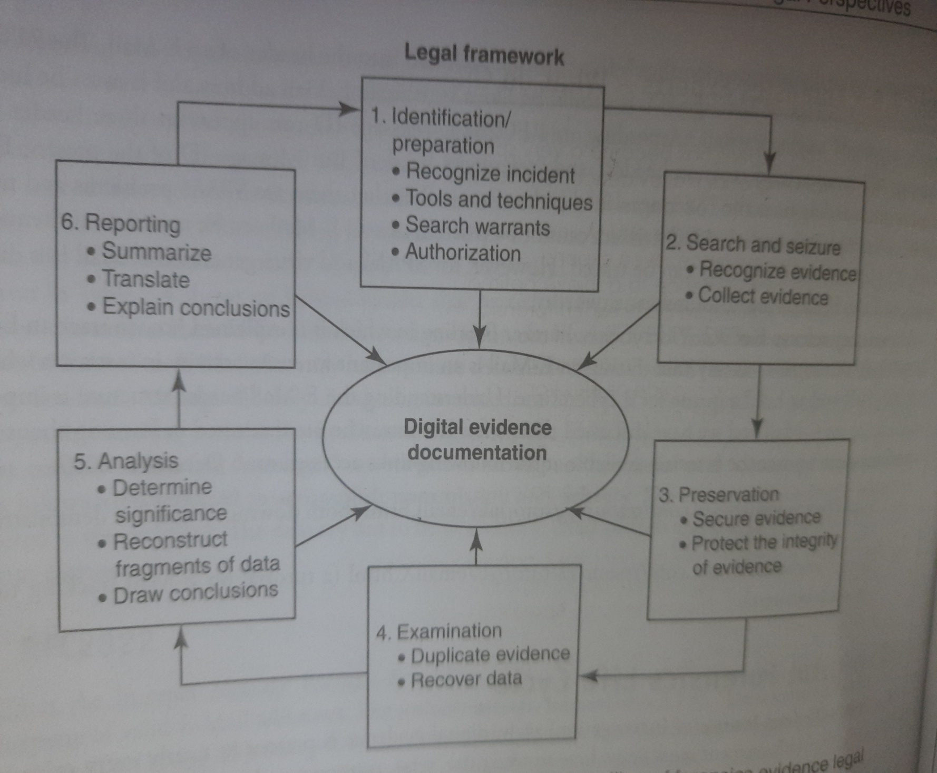
Digital Forensics Process model

Slide 18
Rules for evidence
Is admissible
Is authentic
Is complete
Is reliable
Is understandable and believable

Slide 19
FORENSICS ANALYSIS OF EMAIL
E-mail forensics refers to the study of source and content of e-mail as evidence to identify the actual sender and recipient of a message, date/time of transmission, detailed record of e-mail transaction, intent of the sender, etc.
This study involves investigation of metadata, keyword searching, port scanning, etc. for authorship attribution and identification of e-mail scams.

Slide 20
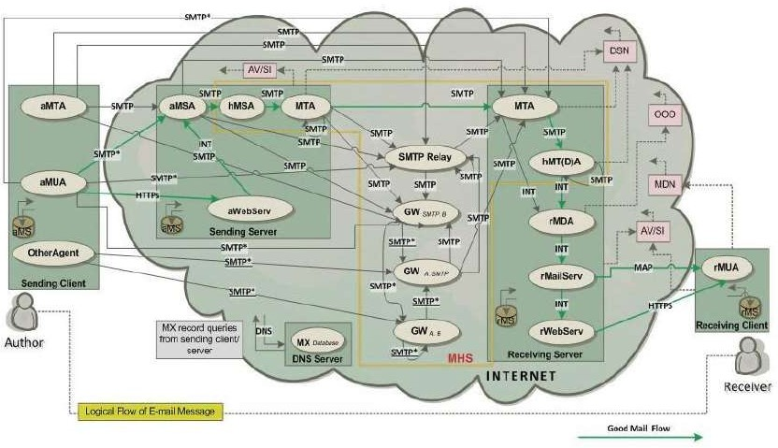
E-mail Architecture

Slide 21
MUA(Mail user agent):
▫ aMUA creates messages and performs initial submission via Mail Submission Agent (MSA)
▫ rMUA processes received mail that includes displaying and disposing of the received message and closing or expanding the user communication loop by initiating replies and forwarding new messages
Message/Mail Store (MS):
▫ Long term message store for MUA which can be located on
a remote server or on the machine running MUA
▫ The MUA accesses the MS either by a local mechanism or by using POP or IMAP.

Slide 22
Mail Submission Agent (MSA):
▫ Accepts the message submitted by the aMUA for posting.
▫ Adds header fields such as Date and Message-ID and expanding an address to its formal Internet Mail Format (IMF) representation. The hMSA is responsible for transiting the message to MTA.
Message/Mail Transfer Agent (MTA):
▫ MTA nodes are in effect postal sorting agents that have the responsibility of retrieving the relevant Mail eXchange (MX) record from the DNS Server for each e-mail to be send and thus map the distinct e-mail addressee’s domain name with the relevant IP address information
▫ A receiving MTA can also perform the operation of delivering e-mail message to the respective mailbox of the receiver on the mail server and thus is also called Mail Delivery Agent (MDA).

Slide 23
Message/Mail Delivery Agent (MDA):
▫ Both hMDA and rMDA are responsible for accepting the message for delivery to distinct addresses.
▫ hMDA functions as a SMTP server engine and rMDA performs
the delivery action
Relays:
▫ Nodes that perform e-mail relaying. Relaying is the process of receiving e-mail message from one SMTP e-mail node and forward it to another one.
Gateway:
▫ Gateway nodes are used to convert e-mail messages from one application layer protocol to other
Web Server (WebServ):
▫ These nodes are the e-mail Web servers that provide the Web environment to compose, send and read an e-mail message.
Mail Server (MailServ):
▫ They represent e-mail servers providing users mail access service using
IMAP or POP3 protocols.

Slide 24
E-mail Client attacks
Malware Distribution:
Hackers with malicious intent can exploit your email client by distributing malware through email messages.
Phishing Attack:
A phishing attack is generally not hazardous to the inner workings of your PC however; it is designed to trick you into revealing your personal information, passwords, or bank account information.

Slide 25
Contd..
Spam Attack:
Spam is unsolicited email or "junk" mail that you receive in your Inbox. Spam generally contains advertisements but it can also contain malicious files.
Denial of Service Attack:
A denial of service attack occurs when the hacker sends multitudes of email messages to your email client in an effort to block you from using your email client or crashing your computer altogether.

Slide 26
E-mail Forensic Investigation Techniques
Various approaches that are used for e-mail forensic are:
Header Analysis – Meta data in the e-mail message in the form of control information i.e. envelope and headers including headers in the message body contain information about the sender and/or the path along which the message has traversed.
Some of these may be spoofed to conceal the identity of the sender. A detailed analysis of these headers and their correlation is performed in header analysis.

Slide 27
Bait Tactics –
The aim of this digital forensic investigation process is to extract and copy the IP address of the culprit. In the bait tactic scenario, an email with HTTP: “<img src=””>” tag will be send to the email address which is under examination.
The email with an image tag will have some image source at some computer that is supervised by the investigators. After that, when the email is opened, a log entry containing the IP address of the recipient is recorded on the HTTP Server hosting the image. This results in the tracking of the sender.
However, if the recipient (sender of the e-mail under investigation) is using a proxy server then IP address of the proxy server is recorded.
The log on proxy server can be used to track the sender of the e-mail under investigation. If the proxy server’s log is unavailable due to some reason, then investigators may send the tactic e-mail containing a) Embedded Java Applet that runs on receiver’s computer or b) HTML page with Active X Object. Both aiming to extract IP address of the receiver’s computer and e-mail it to the investigators.

Slide 28
Server Investigation – In this investigation, copies of delivered e-mails and server logs are investigated to identify source of an e-mail message. E-mails purged from the clients (senders or receivers) whose recovery is impossible may be requested from servers (Proxy or ISP) as most of them store a copy of all e-mails after their deliveries.
Further, logs maintained by servers can be studied to trace the address of the computer responsible for making the e-mail transaction.
However, servers store the copies of e-mail and server logs only for some limited periods and some may not co-operate with the investigators.
Further, SMTP servers which store data like credit card number and other data pertaining to owner of a mailbox can be used to identify person behind an e-mail address

Slide 29
Network Device Investigation
In this form of e-mail investigation, logs maintained by the network devices such as routers, firewalls and switches are used to investigate the source of an e-mail message.
This form of investigation is complex and is used only when the logs of servers (Proxy or ISP) are unavailable due to some reason, e.g. when ISP or proxy does not maintain a log or lack of co-operation by ISP’s or failure to maintain chain of evidence.

Slide 30
Software Embedded Identifiers
Information associated with the email creators, attached files, or documents, which is included in the email message. It can be used by the sender for composing the email. Now, this information can be present in the form of a custom header or MIME content as a Transport Neutral Encapsulation Format (TNEF).
Analyzing email for these details in email digital forensics may reveal some important information related to the sender’s email preferences and the options that could help client-side evidence gathering. This digital forensic investigation method can reveal PST file names, Mac address, Windows login username, etc. of the client’s computer, which is used to send an email message.
Sender Mailer Fingerprints –
Identification of software handling e-mail at server can be revealed from the Received header field and identification of software handling e-mail at client can be ascertained by using different set of headers like “X- Mailer” or equivalent.
These headers describe applications and their versions used at the clients to send e-mail. This information about the client computer of the sender can be used to help investigators devise an effective plan and thus prove to be very useful.

Slide 31
EMAIL FORENSICS TOOLS
Erasing or deleting an email doesn’t necessarily mean that it is gone forever. Often emails can be forensically extracted even after deletion. Forensic tracing of e-mail is similar to traditional detective work. It is used for retrieving information from mailbox files.
MiTec Mail Viewer – This is a viewer for Outlook Express, Windows Mail/Windows Live Mail, Mozilla Thunderbird message databases, and single EML files. It displays a list of contained messages with all needed properties, like an ordinary e-mail client. Messages can be viewed in detailed view, including attachments and an HTML preview. It has powerful searching and filtering capability and also allows extracting email addresses from all emails in opened folder to list by one click. Selected messages can be saved to eml files with or without their attachments. Attachments can be extracted from selected messages by one command.

Slide 32
OST and PST Viewer – Nucleus Technologies’ OST and PST viewer tools help you view OST and PST files easily without connecting to an MS Exchange server. These tools allow the user to scan OST and PST files and they display the data saved in it including email messages, contacts, calendars, notes, etc., in a proper folder structure.
eMailTrackerPro – eMailTrackerPro analyses the headers of an e-mail to detect the IP address of the machine that sent the message so that the sender can be tracked down. It can trace multiple e-mails at the same time and easily keep track of them. The geographical location of an IP address is key information for determining the threat level or validity of an e-mail message.

Slide 33
EmailTracer – EmailTracer is an Indian effort in cyber forensics by the Resource Centre for Cyber Forensics (RCCF) which is a premier centre for cyber forensics in India. It develops cyber forensic tools based on the requirements of law enforcement agencies.

Slide 34
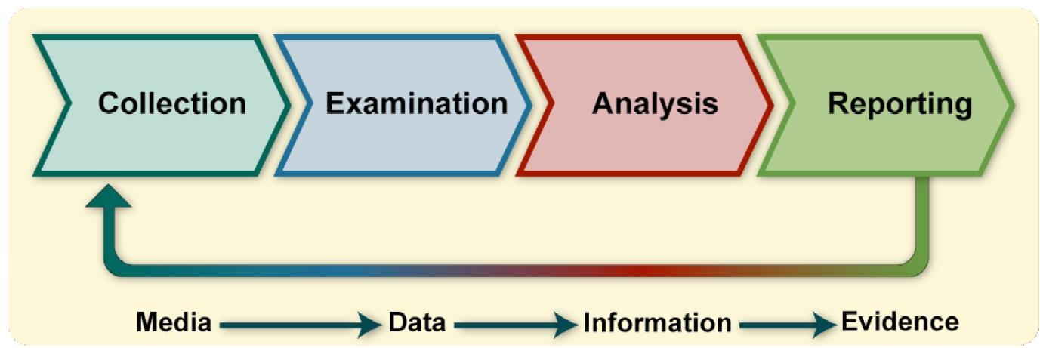
DIGITAL FORENSICS LIFECYCLE

Slide 35
Collection: The first step in the forensic process is to identify potential sources of data and acquire data from them.
Examination: After data has been collected, the next phase is to examine the data, which involves assessing and extracting the relevant pieces of information from the collected data. This phase may also involve bypassing or mitigating OS or application features that obscure data and code, such as data compression, encryption, and access control mechanisms.
Analysis: Once the relevant information has been extracted, the analyst should study and analyze the data to draw conclusions from it. The foundation of forensics is using a methodical approach to reach appropriate conclusions based on the available data or determine that no conclusion can yet be drawn.

Slide 36
Reporting: The process of preparing and presenting the information resulting from the analysis phase.
Many factors affect reporting, including the following:
Alternative Explanations: When the information regarding an event is incomplete, it may not be possible to arrive at a definitive explanation of what happened. When an event has two or more plausible explanations, each should be given due consideration in the reporting process. Analysts should use a methodical approach to attempt to prove or disprove each possible explanation that is proposed.
Audience Consideration. Knowing the audience to which the data or information will be shown is important.
Actionable Information. Reporting also includes identifying actionable information gained from data that may allow an analyst to collect new sources of information

Slide 37
FORENSICS INVESTIGATION:
Forensics are the scientific methods used to solve a crime. Forensic investigation is the gathering and analysis of all crime-related physical evidence in order to come to a conclusion about a suspect.
Investigators will look at blood, fluid, or fingerprints, residue, hard drives, computers, or other technology to establish how a crime took place.
TYPES OF FORENSICS INVESTIGATION
Forensic Accounting / Auditing
Computer or Cyber Forensics
Crime Scene Forensics
Forensic Archaeology
Forensic Dentistry
Forensic Entomology
Forensic Graphology
Forensic Pathology
Forensic Psychology
Forensic Science
Forensic Toxicology

Slide 38
CHALLENGES IN COMPUTER FORENSICS
Digital forensics has been defined as the use of scientifically derived and proven methods towards the identification, collection, preservation, validation, analysis, interpretation, and presentation of digital evidence derivative from digital sources to facilitate the reconstruction of events found to be criminal. But these digital forensics investigation methods face some major challenges at the time of practical implementation.
Digital forensic challenges are categorized into three major heads as per Fahdi, Clark, and Furnell are:
Technical challenges
Legal challenges
Resource Challenges

Slide 39
TECHNICAL CHALLENGES
As technology develops crimes and criminals are also developed with it. Digital forensic experts use forensic tools for collecting shreds of evidence against criminals and criminals use such tools for hiding, altering or removing the traces of their crime, in digital forensic this process is called Anti- forensics technique which is considered as a major challenge in digital forensics world.

Slide 40
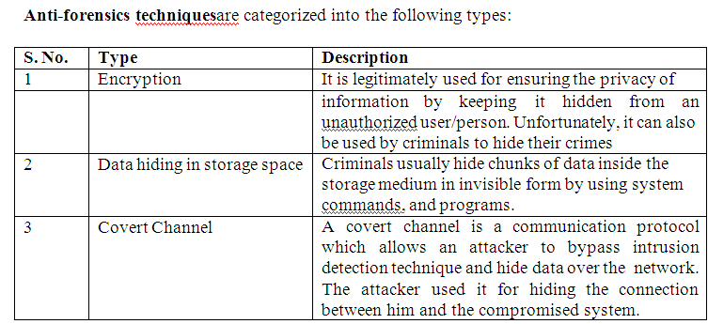

Slide 41
Other Technical challenges are:
Operating in the cloud
Time to archive data
Skill gap
Steganography

Slide 42
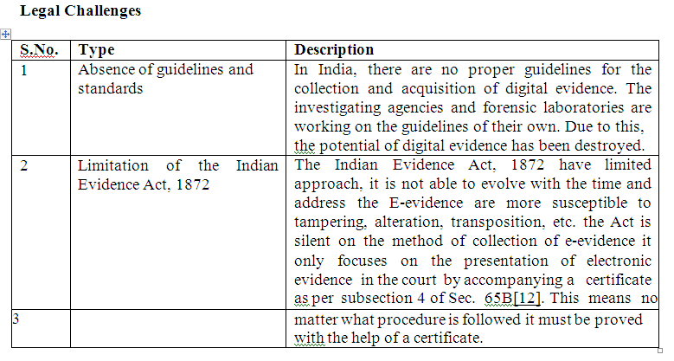

Slide 43
Other Legal Challenges
Privacy Issues
Admissibility in Courts
Preservation of electronic evidence
Power for gathering digital evidence
Analyzing a running computer

Slide 44
Resource Challenges
As the rate of crime increases the number of data increases and the burden to analyze such huge data is also increasing on a digital forensic expert because digital evidence is more sensitive as compared to physical evidence it can easily disappear. For making the investigation process fast and useful forensic experts use various tools to check the authenticity of the data but dealing with these tools is also a challenge in itself.
Types of Resource Challenges are:
Change in technology
Due to rapid change in technology like operating systems, application software and hardware, reading of digital evidence becoming more difficult because new version software’s are not supported to an older version and the software developing companies did provide any backward compatible’s which also affects legally.
Volume and replication
The confidentiality, availability, and integrity of electronic documents are easily get manipulated. The combination of wide-area networks and the internet form a big network that allows flowing data beyond the physical boundaries. Such easiness of communication and availability of electronic document increases the volume of data which also create difficulty in the identification of original and relevant data.

Slide 45
WHAT IS FORENSIC AUDIT ?
A forensic audit, refers to the application of accounting methods for detection and gathering evidence of frauds, embezzlement, or any other such white-collar crime.
It is an examination of a company’s financial records to derive evidence which can be used in a court of law or legal proceeding.
The failure of some formerly prominent public companies such as Enron, WorldCom, Xerox Corporation and Satyam Computer Services fueled the prominence of forensic auditing

Slide 46

FORENSIC AUDITORS
They are retained by banks, courts, business communities, police forces, lawyers, insurance companies, government regulatory bodies and organizations.
Highly specialized
Scrutiny of the options
Effective listener
Knowledge of techniques and law

Slide 47
HOW IS FORENSIC AUDIT INVESTIGATION CONDUCTED ?
Accepting the
investigation
Planning the
investigation
Perform the analysis
Gathering the evidence
Reporting
Court Proceedings

Slide 48
Step 1 – Accepting the Investigation
The firm must ascertain whether or not they have the necessary tools, skills and expertise to go forward with such an investigation. They need to do an assessment of their own training and knowledge of fraud detection and legal framework
Step 2 – Planning the Investigation
The auditor(s) must carefully ascertain the goal of the audit so being conducted, and to carefully determine the procedure to achieve it, through the use of effective tools and techniques. Planning also includes the identification of the best mode to gather evidence.

Slide 49
Step 3 – Gathering the evidence
In forensic auditing specific procedures are carried out in order to produce evidence. The investigators can use the following techniques to gather evidence :
Testing controls which identifies the weaknesses,
Using analytical procedures to compare trends over time
Applying computer-assisted audit techniques,
Discussions and interviews with employees
Substantive techniques such as reconciliations, cash counts and reviews of documentation.

Slide 50
Step 4 – Perform the analysis
The actual analysis performed may involve calculating economic damages, summarizing a large number of transactions, tracing of assets, present value considerations
Step 5 – Reporting
After investigating and gathering evidence, the investigating team is expected to give a report of the findings of the investigation, and also the summary of the evidence and conclusion about the loss suffered due to the fraud.
Step 6 – Court Proceedings
The last stage expands over those audits that lead to legal proceedings. The auditors are called to the Court, and also included in the advocacy process.

Slide 51

TYPES OF INVESTIGATIONS UNDER FORENSIC AUDIT
Asset Misappropriation
This includes misappropriation of cash, raising fake invoices, payments made to non-existing suppliers or employees
It happens when people who are entrusted to manage the assets of an organization, steal from it.
The direct hit is on the cash flow of the organization.

Slide 52

Corruption
Corruption is a major obstacle at corporate levels, and also to socio- economic development. It can surface in various forms such as -
Bribery
Extortion
Conflict of interest

Slide 53

Financial Statement Fraud (FSF)
Financial statement fraud is the deliberate misrepresentation, misstatement or omission of data for the purpose of misleading the reader and creating a false impression of an organization’s financial strength.
The common practice is deferring revenues or expense in a different time period to give the appearance of consistent earnings or growth.

Slide 54
FORENSIC AUDIT TECHNIQUES
General Audit Techniques
Testing defenses - A good forensic audit technique is to attempt to circumvent these defenses yourself. This technique requires you to put yourself in the shoes of the suspect and think accordingly.
Statistical and Mathematical Techniques
Trend Analysis - Careful review of the historical norms
Ratio Analysis – Analysis of ratios report on the fraud health by identifying the possible symptoms of the fraud.

Slide 55
FORENSIC AUDIT TECHNIQUES
Technology based/ digital forensic techniques
Every transaction leaves a digital footprint in the computer driven society. Many digital enabled forensic tools are available to assist the auditor such as –cross drive analysis, live analysis, Encase, MD5, Tracking log files, PC system log, Steganography, Free log tools.
Computer aided audit tools (CAATs)
It is the practice of using computers to automate the IT audit processes. The CAAT tool supports the forensic accounting in which larger amount can be diverted to the analytical form and it also prompts where the tool detects the fraud..

Slide 56

FORENSIC AUDIT TECHNIQUES
Data Mining
Data mining is an analysis process used to examine data sets or metadata to identify patterns, anomalies, and trends to answer business queries and provide predictive value for future events. It incorporates algorithms to explore, analyze, classify, relate, and partition data sets

Slide 57
FORENSIC AUDIT TECHNIQUES
Software and tools
Generalized audit software is a category of CAAT to undertake data extraction, summarization and analytical skills. Currently the latest version of generalized audit software includes the audit command language, interactive data extraction and analysis (IDEA) and Panaudit .
Due to the shortcomings of generalized audit software, common software tools have become more popular over the time period. Spreadsheets like Ms Excel, Lotus etc, RDBMS like MsAccess etc and report writers like Crystal reports etc are few examples of CST.

